Slide 1



Agricultural Crop Production Data Analysis -RUDRA
View in Power BI
Mitesh K
Sujay V Kulkarni
Mohammed Ismail
Pema Tshering Sherpa
Rakshitha K
Last data refresh:
12/9/2023 12:59:25 PM UTC
Downloaded at:
12/9/2023 1:23:00 PM UTC

Slide 2
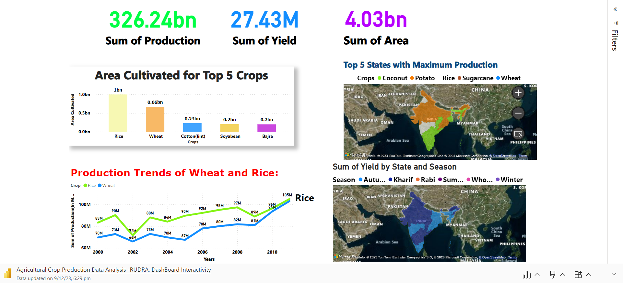
RUDRA-Resourceful Unit for Data Research and Analysis

Slide 3

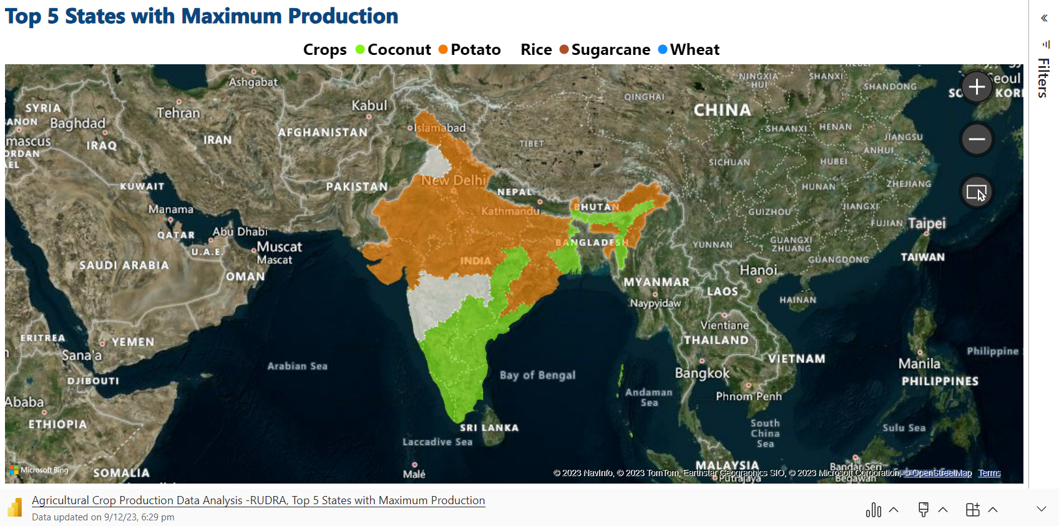
Microsoft Power BI

Slide 4
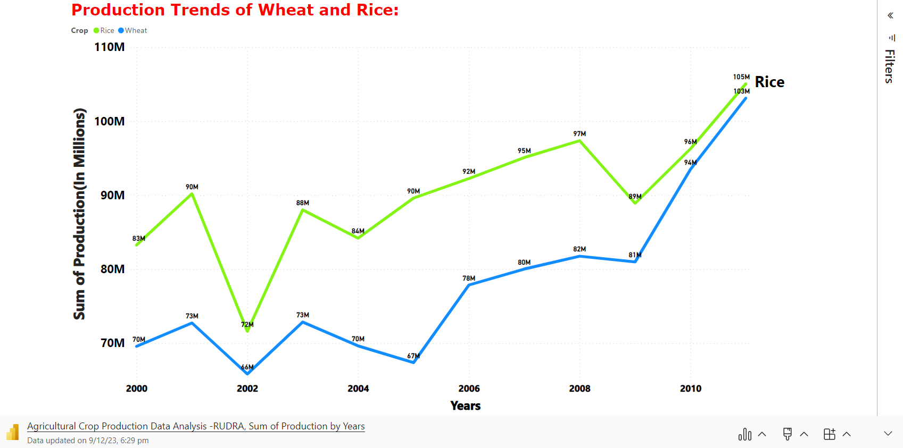
Microsoft Power BI

Slide 5
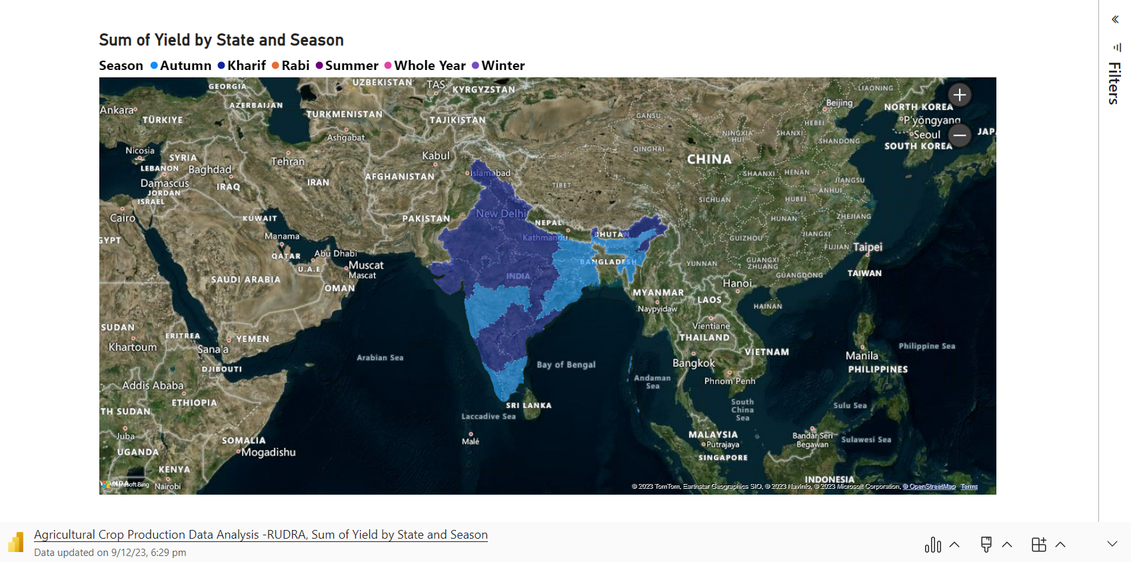
Microsoft Power BI

Slide 6
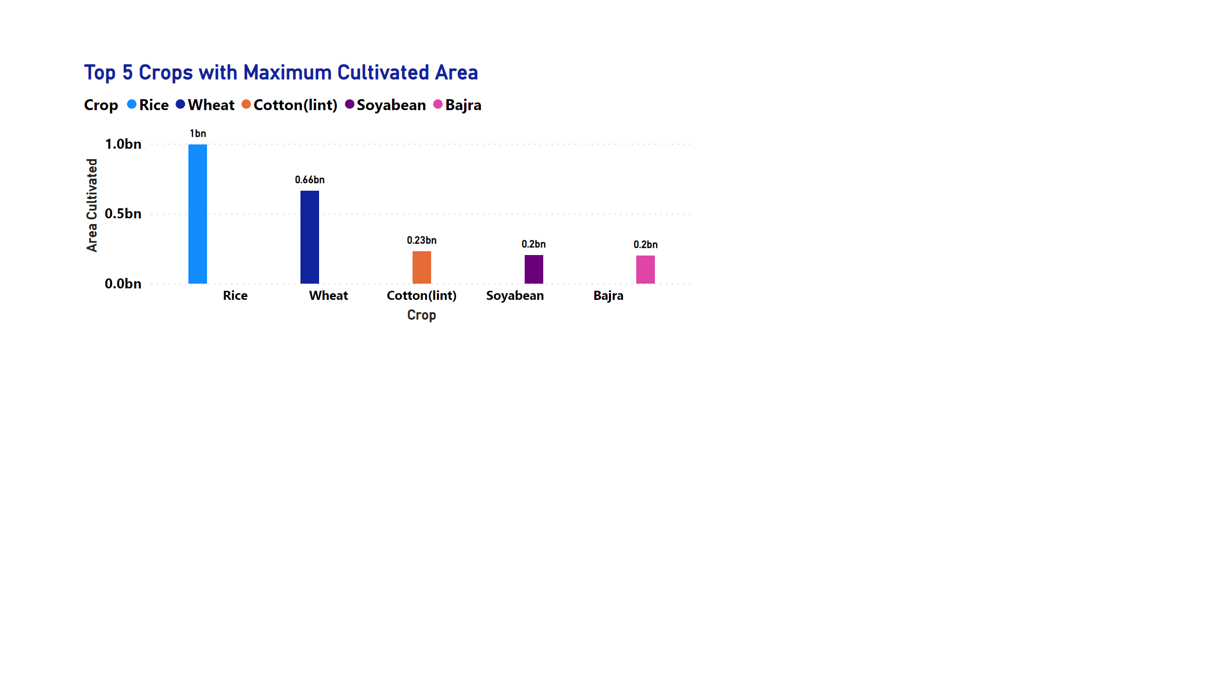
Page 2
Notes:
Top 5 Crops with Maximum Cultivated Area
No alt text provided

Slide 7
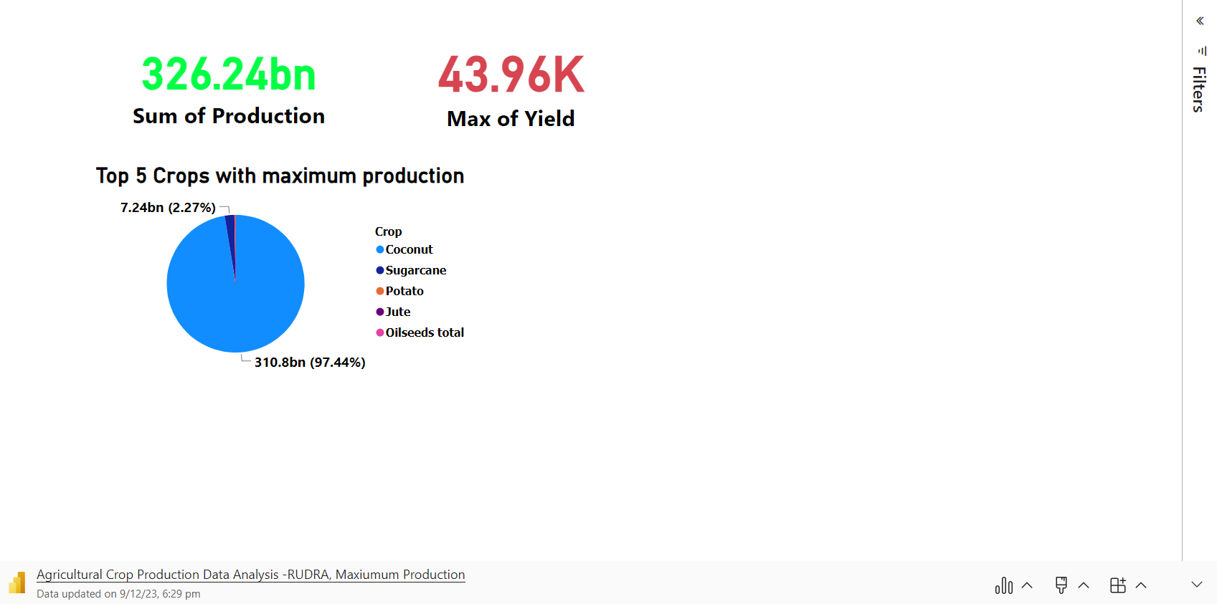
Microsoft Power BI

Slide 8
THANK YOU
View in Power BI
Mitesh K
Sujay V Kulkarni
Mohammed Ismail
Pema Tshering Sherpa
Rakshitha K
Last data refresh:
12/9/2023 12:59:25 PM UTC
Downloaded at:
12/9/2023 1:23:00 PM UTC

